Slide 1
Fresh Grads – Group Project
Online Mobile Store application

Slide 2
Problem Statement
To Create an Application for Online Mobile Store Application
Customer should be able to search,buy, modify and order the mobiles.
Admin should be able to perform below operations:
1.Customer Management
2.Mobile Management
3.Order Management

Slide 3
Road Map
Application will be developed in following Sprints –
Core Java +JPA with Hibernate
Spring Boot + Rest Controller + JPA with Hibernate
Angular for UI design (Front End) + Integration with previous Sprint

Slide 4
Plan
Design
Generate the skeleton as per class design provided
TDD approach
Identify test cases for each module
Write Failing Test cases
Convert the Test Cases in GREEN
Implement the case study in incremental manner

Slide 5
Modules
Login Module
Customer Module
Admin Module
Mobile Module
Cart Module
Order Module

Slide 6
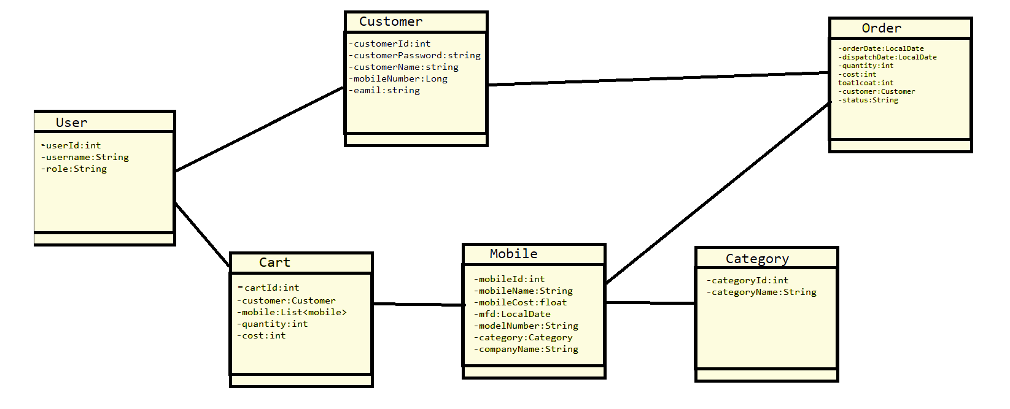
Class Design
POJO Classes:

Slide 7
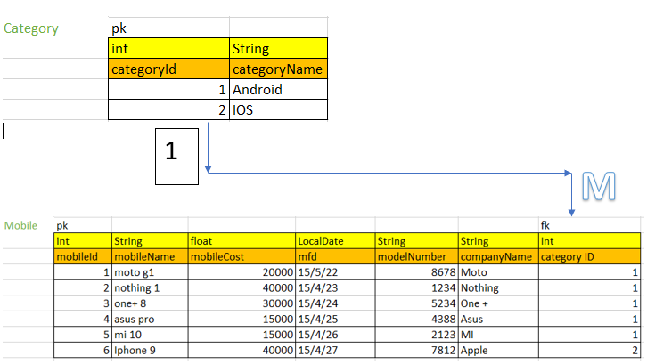
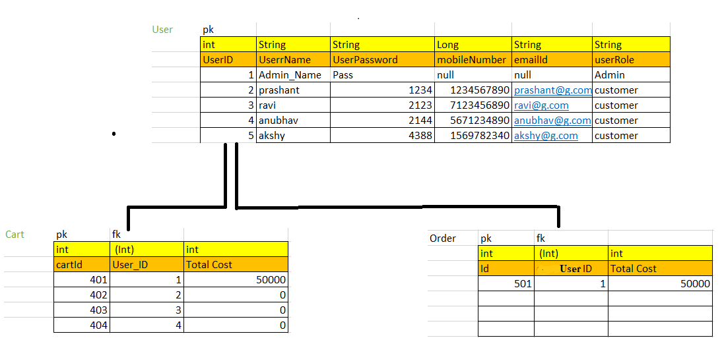

Slide 8




Questions

